Slide 1
CubeSat Constellations: Maximizing Science Data Volume
Stephen Ennis – MAI Computer Engineering 16/17
Supervised By: Dr. Jonathan Dukes

Slide 2
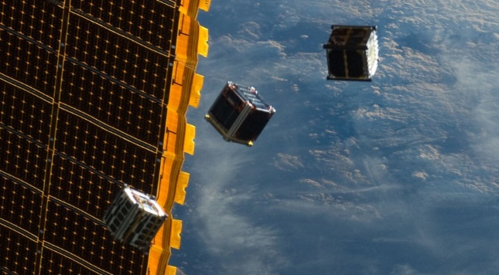
CubeSats
One unit is 10 cm cube
Multiple units combined up to 6 units
Extensive use of commercial of the shelf hardware
Low earth orbit 160-2000km (~500km)
Typical one unit batteries supply 25 to 50 watt hours
Communications: 1w crosslink 4w downlink
Currently about $75,000 for construction and launch

Slide 3
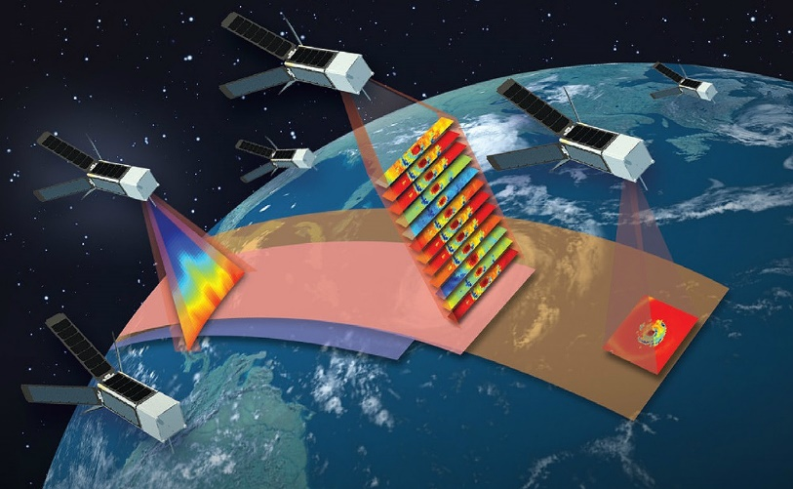
Constellations
Satellites deployed in some formation
CubeSat constellation coming soon qb50
In our case we will consider multi-orbit constellations
Individual CubeSat orbits constantly changing
Basic CubeSat formation flying has been demonstrated
For now, CubeSat constellations communicate via omni-directional antennae as CubeSat attitude control develops

Slide 4



Missions
NASA’s EDSN … blew up
NASA’s Nodes used EDSN two leftovers
CNSA’s Tianwang-1 (TW) is by far the most successful networked CubeSat mission thus far
TW showed basic formation flying and implemented a new SDR based inter-satellite link (ISL) approach
Several missions on the horizon: QB50, Tropics, CPOD, GomX-4, AIM COPINS and so on

Slide 5

Scenario: Objective
Science!
Maximize the amount of collected science data
Maximize downlink throughput
Maximize average CubeSat power -> Maximize science data collected within mission lifetime
Sending data to ground (downlink) is more expensive than sending data between nodes (crosslink)
Opportunities to downlink are within fixed periods

Slide 6
Scenario: CubeSat
Science!
If necessary send science data to the CubeSat elected to downlink
Participate in the election of downlink CubeSat
Potentially receive commands and/or network state routed from ground
Research focus placed on movement of science data
Can get GPS time and location and will be preloaded with ground fly-over windows.

Slide 7
Collection challenge
The constellation must take advantage of ground station fly-overs in order to maximize data downlink
Downlink speeds around 9.6kbps
Downlink consumes considerable power
CubeSats must share downlink duty
Accurately modelling constellation configuration on a single CubeSat is too costly
Constellation may be partitioned

Slide 8
Proposed Approach
Draft a hypothetical modern CubeSat constellation mission
Payload, Orbit, Power, Comms, Mission Lifetime, etc.
Use dynamics modelling software to model a sample constellation based on successful missions
Analyze dynamics model to extract communications windows and ranges
Use assumptions and analysis to inform a network simulation

Slide 9

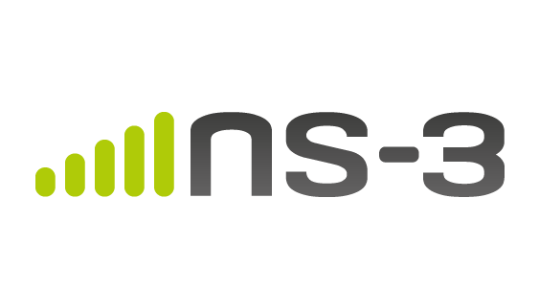
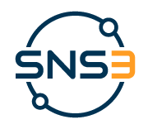
STK11 & SNS3
STK is powerful astro/aerospace mission design and analysis tool
STK can be used to model ground station fly-overs and inter-satellite ranges
SNS3 is an extension of the well supported network simulator 3
SNS3 was developed through ESA and greatly improves the dynamics modelling capabilities of ns-3 for Satellite missions

Slide 10
Expected results
The network simulation will be tested against a number of approaches to maximize science data volume
Power hungry high throughput approaches
Avoiding saturation of downlink
Resistance to partition

Slide 11
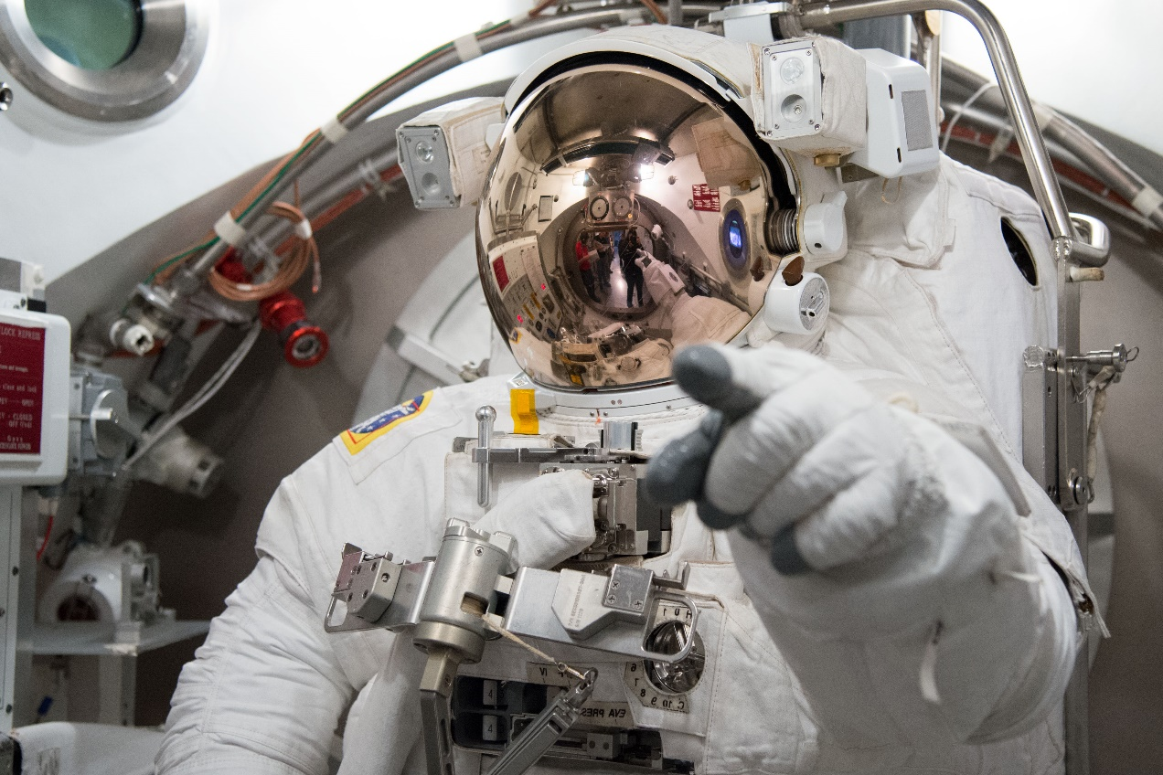
Questions

